Slide 1
UltraLite Coding
Nicholas Walter
Max Maier
Tyler Hogenson
Ben Finnerty
Spencer Lofing

Slide 2
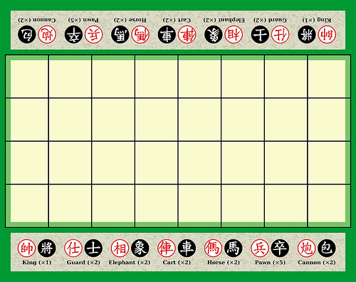
Banqi
Description of Banqi
Half/Blind Chinese Chess – game consists of tokens with various power levels, each placed face-down on the board in a random position. Tokens must be flipped face up (revealing color/power level) before you can move them – higher power level tokens can take lower power level tokens. Soldier can take General, General cannot take Soldier, Cannon can take anything (by jumping).

Slide 3
How did we work?
We had regular weekly meetings.
Usually on Sundays.
We communicated consistently, mostly via text.
We broke up work to be done as Issues on GitHub.

Slide 4
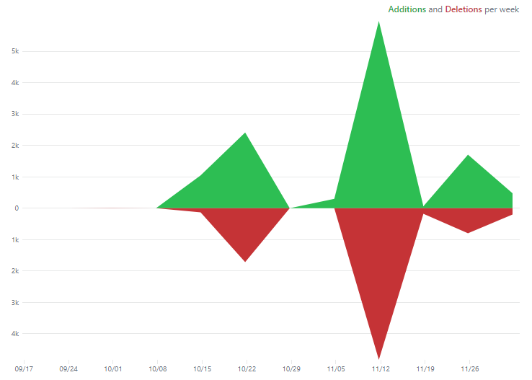
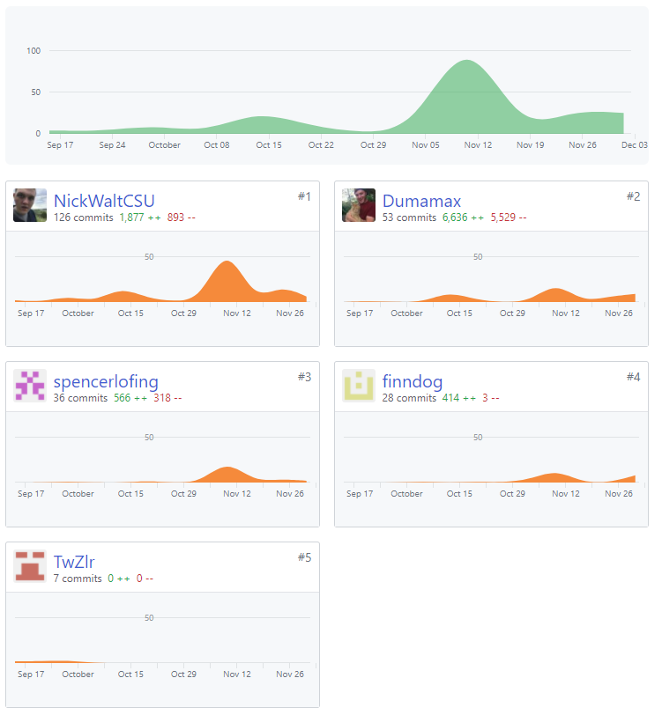
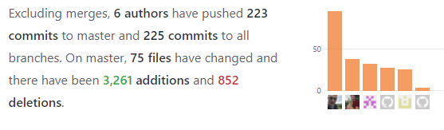
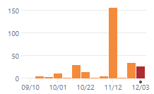
More Information…

Slide 5
Code Improvements (Issues Closed)
#72 – Speed up Queries (Spencer)
#75 – Implement Forfeit Game, UI Side (Tyler)
#76 – Improvements to Active Games (Nicholas)
#77 – Add a Refresh to the Board (Tyler)
#82 – Hash Passwords (Spencer)
#83 – Fix Package Extensions (Max)
#86 – Fix Deregister (Spencer)
#88 – Show Color of User on Board (Tyler)
#90 – Implemented Recommended Changes to Code (Max)
#91 – Implement Forfeit Game, Database Side (Spencer)
#93 – Implement Creator Color (Nicholas)
#95 – Fix Graveyard Issue (Nicholas, Max)
#106 – Implement AI (Max, Nicholas & Tyler)

Slide 6
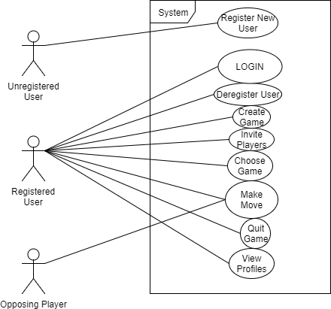
Use Case Document

Slide 7
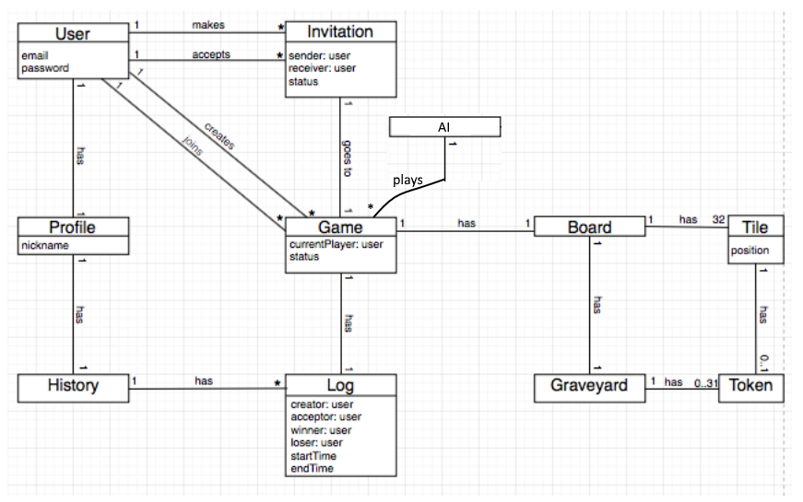
Domain Model Document

Slide 8
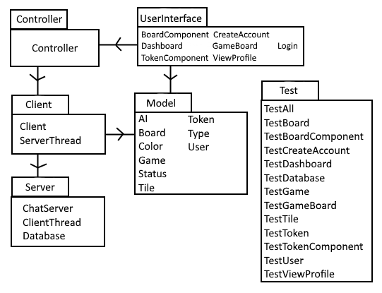
Design Document, Part 1, Package Diagram

Slide 9
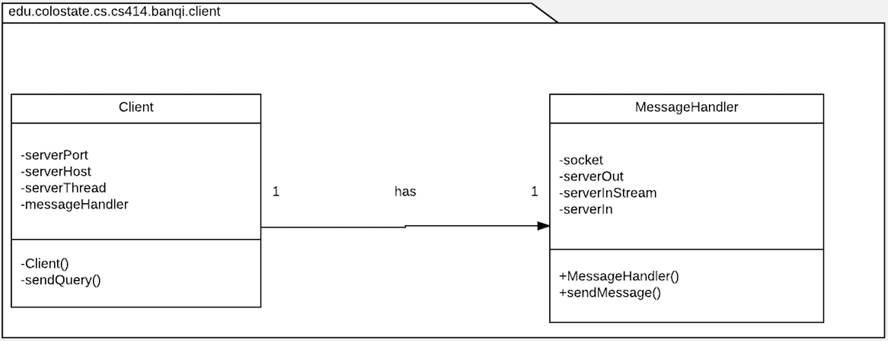
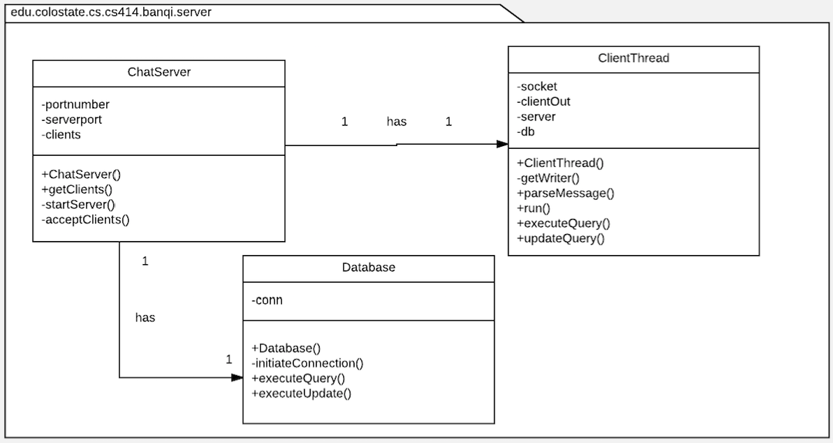
Design Document, Part 2, Design Class Diagram

Slide 10
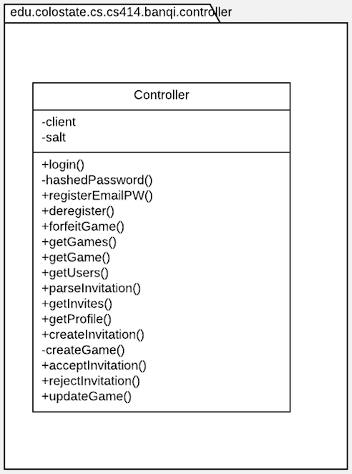
Design Document, Part 2, Design Class Diagram

Slide 11
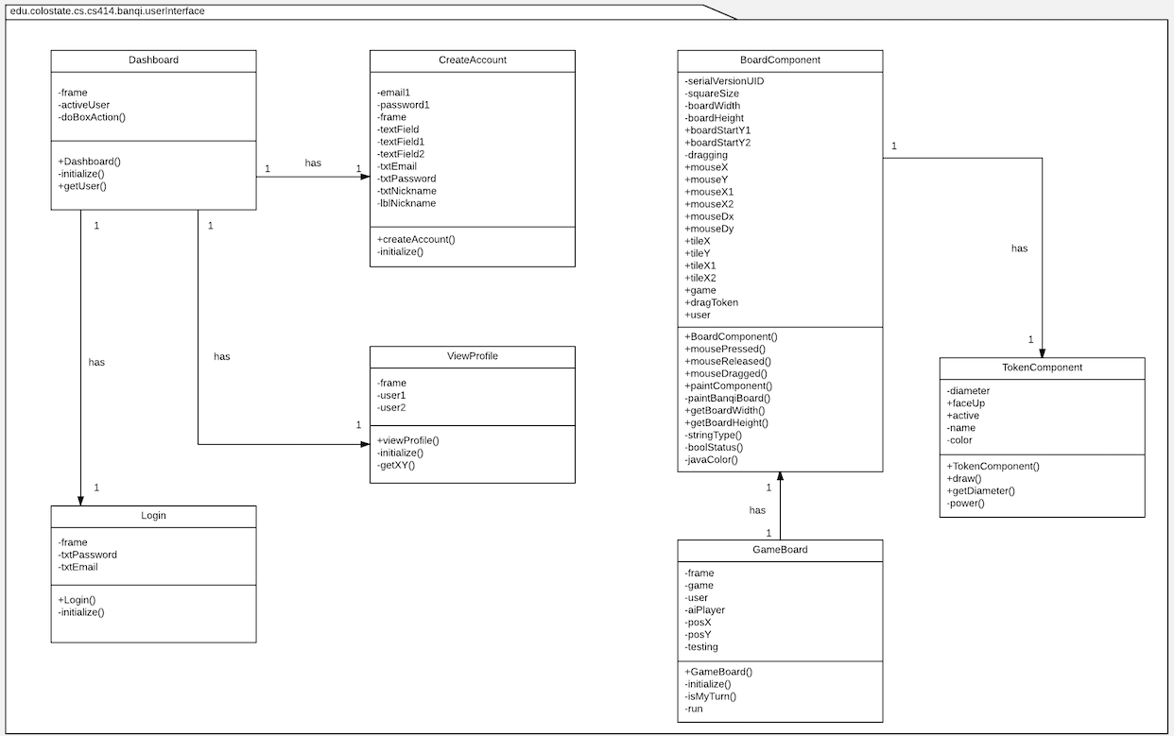
Design Document, Part 2, Design Class Diagram

Slide 12
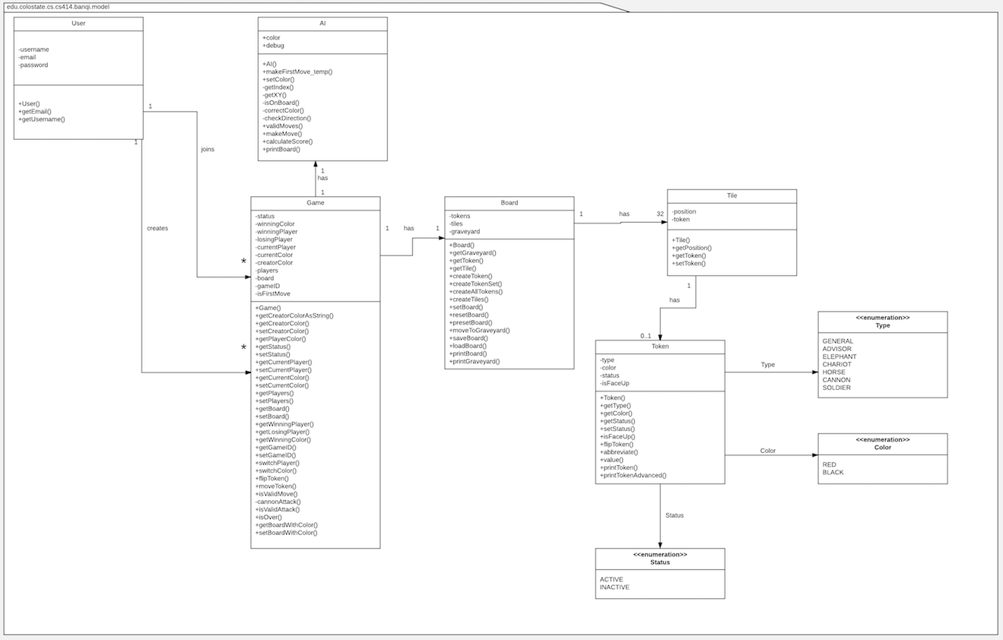
Design Document, Part 2, Design Class Diagram

Slide 13
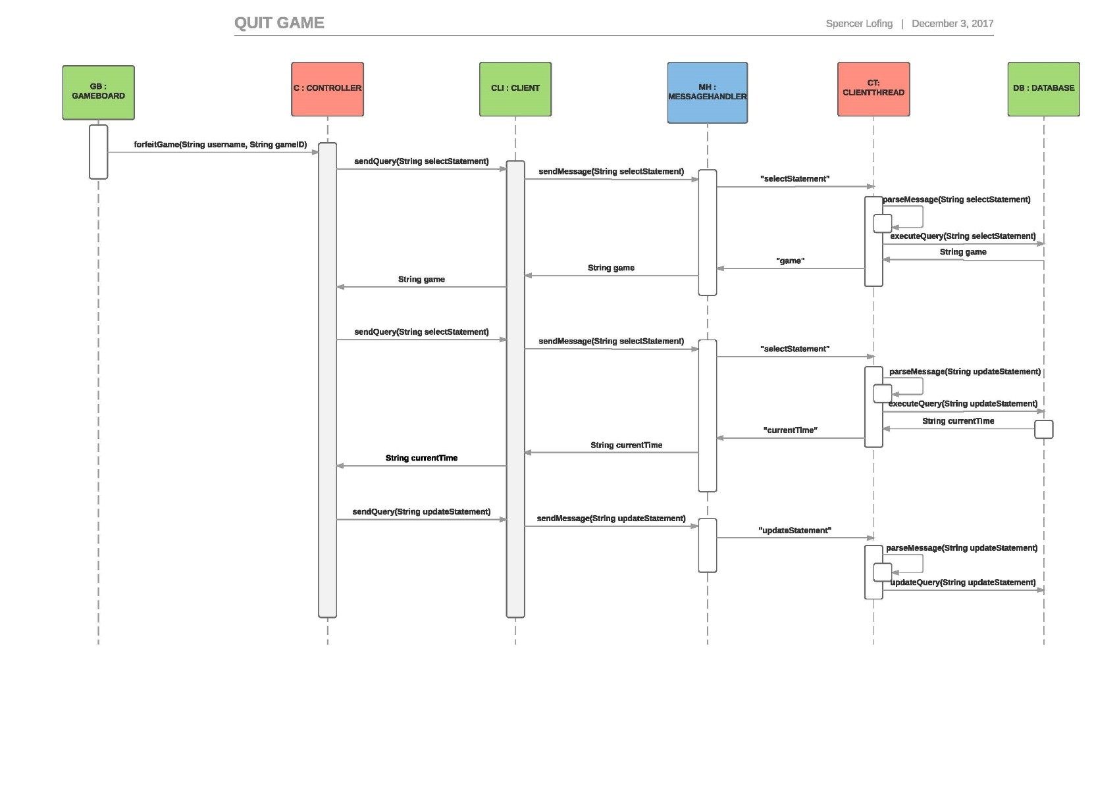
Design Document, Part 3, Sequence Diagram 1

Slide 14
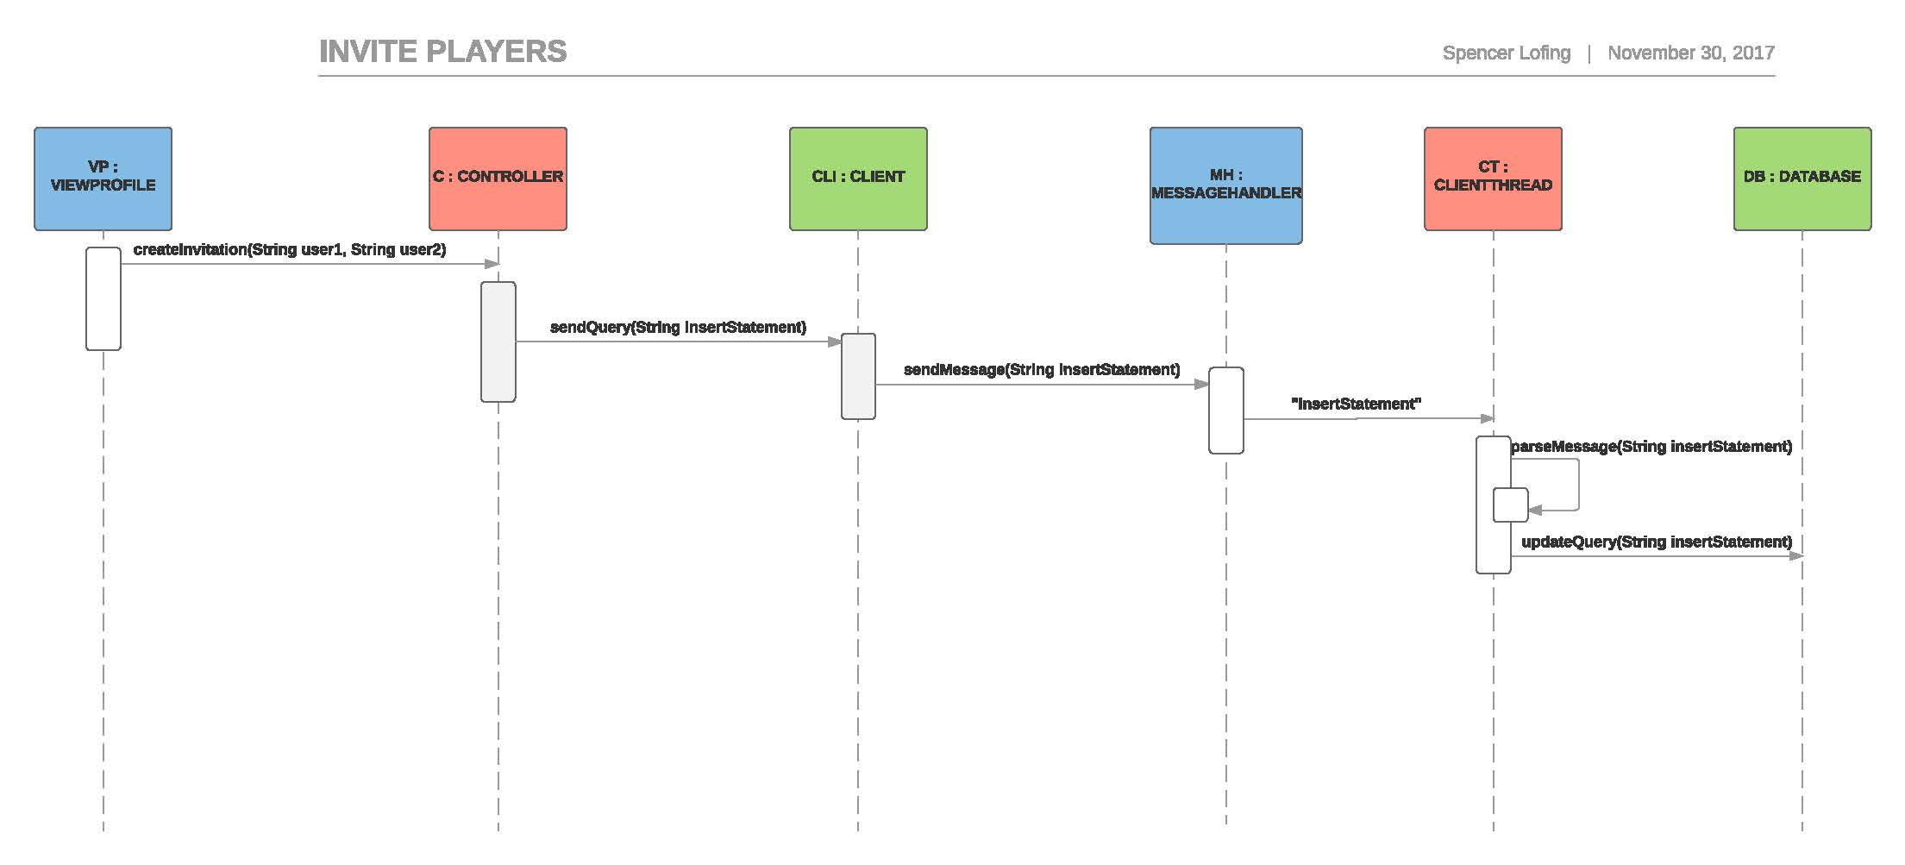
Design Document, Part 3, Sequence Diagram 2

Slide 15
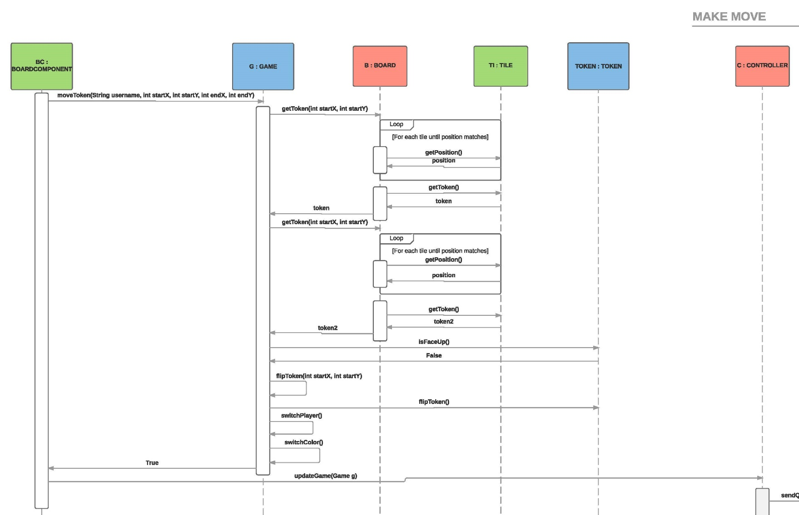
Design Document, Part 3, Sequence Diagram 3.1

Slide 16
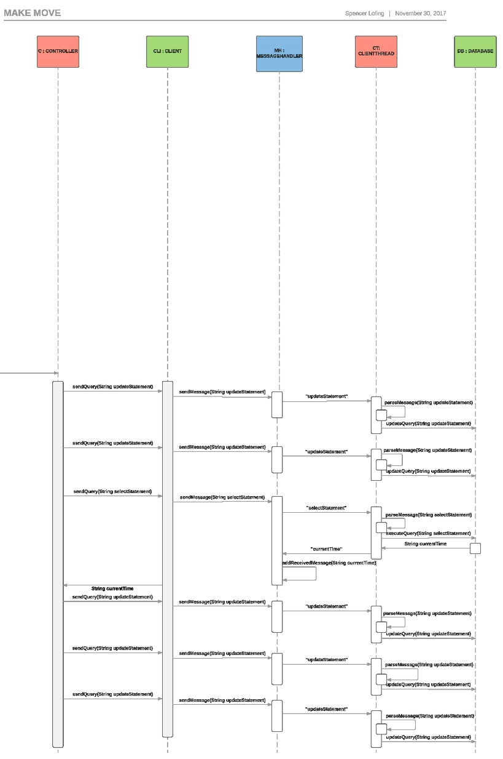
Design Document, Part 3, Sequence Diagram 3.2

Slide 17
Testing Document
Test Document
Test 1:
Description: A user can register
Preconditions: A user enters a valid email, password, and a unique nickname
Steps:
A user starts the project and is directed to the login page
The user clicks on Register User.
The user enters an email, test@test.com
The user enters a password, test.
The user enters a nickname, test123.
Expected Result: A new user has been registered and a message is shown that indicates a new user has been registered.
Postconditions: A new user is added to the database
Status: Pass
Test 2:
Description: A registered user is able to login to the system
Preconditions: A user enters an email and password into the login page
Steps:
A user who has been registered enters their email
That user enters their password
The user clicks login
Expected Result: The user is directed to the game dashboard
Postconditions: The user is logged in to the system
Status: Pass
Test 3:
Description: A registered user can deregister their account
Preconditions: A user enters their credentials and clicks deregister
Steps:
User enters email
User enters password
User clicks deregister button
Expected Result: The user is presented a message that they have been deregistered
Postconditions: The account for the user is deleted from the database
Status: Pass

Slide 18
Testing Document
Test 4:
Description: A registered user can invite another registered user to a game
Preconditions: A user types another user’s nickname to send an invite
Steps:
User types another user’s nickname into text box.
Expected Result: The user that is sent the invite receives a notification to join a game
Postconditions: An invite is sent to the user
Status: Pass
Test 5:
Description: A registered user that has logged in can create a new game
Preconditions: A user has logged in and clicks “Create Game”
Steps:
A user logs in
That user clicks create game button
Expected Result: A new game is created
Postconditions: The start of a new game pops up
Status: Pass
Test 6:
Description: A user can choose to play a game that they are currently involved in
Preconditions: A user has logged in, joined multiple games, and chooses a game to play
Steps:
A user logs in
That user joins a game or creates a game
The user can click another game ID in the side panel to change the game they are playing
Expected Result: The user is transferred from one game they are playing to another
Postconditions: The game board that belongs to the game chosen by the user pops up
Status: Pass

Slide 19
Testing Document
Test 7:
Description: A user that is currently involved in a game can make a move
Preconditions: The user can drag a piece to another tile that has an opponent’s piece on it
Steps:
A user clicks and drags one of their pieces to an adjacent tile
The piece they are moving has a higher rank than the piece they are dragging to
Expected Result: The token on the adjacent tile is removed from the board
Postconditions: The token that is taken is taken off the board and added to the graveyard
Status: Pass
Test 8:
Description: A user that is currently involved in a game can quit that game
Preconditions: A user can click on the “Quit Game” button
Steps:
A user joins a game
A user quits the game
Expected Result: The game board disappears and the game ID is removed from the users current games
Postconditions: The game the user is involved in is deleted
Status: Pass
Test 9:
Description: A user can view another user’s profile
Postconditions: A user clicks on “View Profile” and enters another user’s nickname
Steps:
A user logs into the system
A user clicks on “View Profile” in the dashboard
A user enters another user’s nickname
Expected Result: A user is directed to another user’s profile
Postconditions: Another user’s profile is presented
Status: Pass

Slide 20
Development Manual
Development Manual
Tools needed to begin development of product:
Eclipse (https://www.eclipse.org/downloads/)
MySQL (https://dev.mysql.com/downloads/repo/)
Git (https://git-scm.com/downloads)
Steps to set up MySQL:
Start MySQL server on a local machine
Download mysql-connector-java-5.1.44-bin.jar into local project
Steps to be taken to work on Project in Eclipse:
Attain git tools in eclipse by clicking on Window, Show View, Other, Git, Git Repositories & Git Staging
Clone Github repository by clicking on “Clone a Git Repository and add the clone to this view” button in Eclipse
Then, a new window will appear and click on “Clone URI”
Go to https://github.com/NickWaltCSU/cs414-f17-301-UltraLiteCoding, and click on “Clone or Download”
Copy the URL that appears and copy it into the URI text box that appears when Step 3 is performed.
To get the latest version of the project, right click on the repository, go to “Team”, “Switch”, “master”
Right click on the repository again, go to “Team”, “Fetch from Upstream”, then “Pull”
Start making updates or changes to the project by making a new local branch.
Right click on the repository and select “Team”, “Switch To”, “New Branch”
Any changes made will appear in Git Staging area in the unstaged commits text box
To submit these changes to the Github repository, drag changed files to the staged commits text box and click on Commit and Push

Slide 21
Development Manual
Steps to be taken to run Banqi:
Run the server so users can play other users on different machines and can retrieve information from the database
Run Login, and a window will appear with email and password text boxes.
If you already have created account, enter your email and password and click “Login”
If you have not created an account, click “Create Account” and enter credentials
Once logged in, another dashboard window will appear where you can pick another user to send an invite to.
You can also select a user and click view profile to see a history of games and win percentage
If you are sent an invitation, you can either accept or reject the invitation
If you accept the invitation, a game board will appear and a new game is started

Slide 22
Refactoring and Design Pattern List
Separated classes into MVC layout
Model contains all game logic
View contain UI elements
Controller helps with server and database interaction
Implemented Façade Pattern
Mainly within Model package
Extraction of Code
Rearranged class structure to reduce coupling
Removed unneeded/unused classes
Log, Profile, Invitation

Slide 23
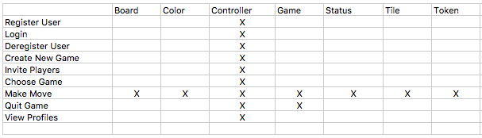
Traceability Link Matrix

Slide 24
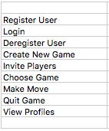
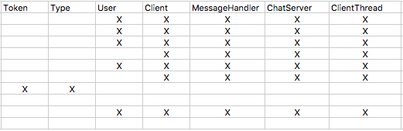
Traceability Link Matrix

Slide 25
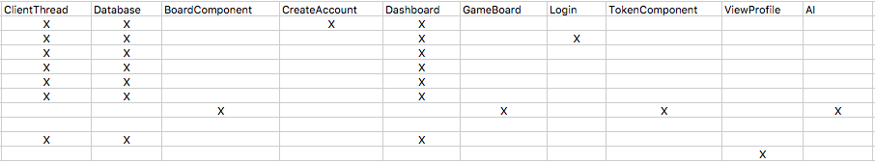
Traceability Link Matrix

Slide 26
Challenges and Lessons Learned
Teamwork:
Challenge: we struggled to follow through on our plans.
Lesson: make more manageable plans.
Communication:
Challenge: we struggled to communicate our difficulties.
Lesson: communicate our difficulties.
Software Design:
Challenge: we struggled to do TDD or use Agile Methodology.
Lesson: making more time for work allows us to work how we want to.
Software Development:
Challenge: we struggled to implement as many design patterns as we would’ve liked.
Lesson: making more time for work allows us to implement what we want to.
Commit Log:
Challenge: 156 commits the week of November 12th.
Lesson: ensure all group members are doing their parts before the weekend before the due date.

Slide 27
Demo

